Slide 1

No SQL vs. SQL Databases
Arem Atoui
Institut supérieur d’informatique et multimédia- GOMYCODE
Année universitaire 2022-2023

Slide 2
What is a database?
✔ Define Database
A database is an organized collection of structured information, or data, typically stored electronically in a computer system. A database is usually controlled by a database management system (DBMS). Together, the data and the DBMS, along with the applications that are associated with them, are referred to as a database system, often shortened to just database.
The data can then be easily accessed, managed, modified, updated, controlled, and organized. Most databases use structured query language (SQL) for writing and querying data.

Slide 3
What is a Database Management System (DBMS) ?
A database typically requires a comprehensive database software program known as a database management system (DBMS). A DBMS serves as an interface between the database and its end users or programs, allowing users to retrieve, update, and manage how the information is organized and optimized. A DBMS also facilitates oversight and control of databases.
Some examples of popular database software or DBMSs include MySQL, Microsoft Access, Microsoft SQL Server, FileMaker Pro, Oracle Database, and dBASE.

Slide 4
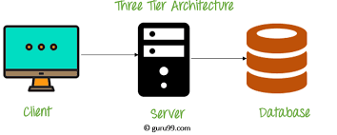
DBMS Architecture

Slide 5
What is a MYSQL database?
MySQL is an open source relational database management system based on SQL. It was designed and optimized for web applications and can run on any platform.
As new and different requirements emerged with the internet, MySQL became the platform of choice for web developers and web-based applications. Because it’s designed to process millions of queries and thousands of transactions, MySQL is a popular choice for ecommerce businesses that need to manage multiple money transfers. On-demand flexibility is the primary feature of MySQL.

Slide 6
Database - Advantages & Disadvantages
Advantages
Reduced data redundancy
Reduced updating errors and increased consistency
Greater data integrity and independence from applications programs
Improved data access to users through use of host and query languages
Improved data security
Reduced data entry, storage, and retrieval costs
Facilitated development of new applications program

Slide 7
Database - Advantages & Disadvantages
Disadvantages
Database systems are complex, difficult, and time-consuming to design
Substantial hardware and software start-up costs
Damage to database affects virtually all applications programs
Extensive conversion costs in moving form a file-based system to a database system
Initial training required for all programmers and users

Slide 8
Differences between SQL and NOSQL
 | SQL Databases | NoSQL Databases
Data Storage Model | Tables with fixed rows and columns | Document: JSON documents, Key-value: key-value pairs, Wide-column: tables with rows and dynamic columns, Graph: nodes and edges
Examples | Oracle, MySQL, Microsoft SQL Server, and PostgreSQL | Document: MongoDB and CouchDB, Key-value: Redis and DynamoDB, Wide-column: Cassandra and HBase, Graph: Neo4j and Amazon Neptune
Schemas | Rigid | Flexible
Joins | Typically required | Typically not required

Slide 9
Mongodb – datatypes ?
MongoDB supports many datatypes. Some of them are −
String − This is the most commonly used datatype to store the data. String in MongoDB must be UTF-8 valid.
Integer − This type is used to store a numerical value. Integer can be 32 bit or 64 bit depending upon your server.
Boolean − This type is used to store a boolean (true/ false) value.
Double − This type is used to store floating point values.
Min/ Max keys − This type is used to compare a value against the lowest and highest BSON elements.
Arrays − This type is used to store arrays or list or multiple values into one key.
Object − This datatype is used for embedded documents..

Slide 10
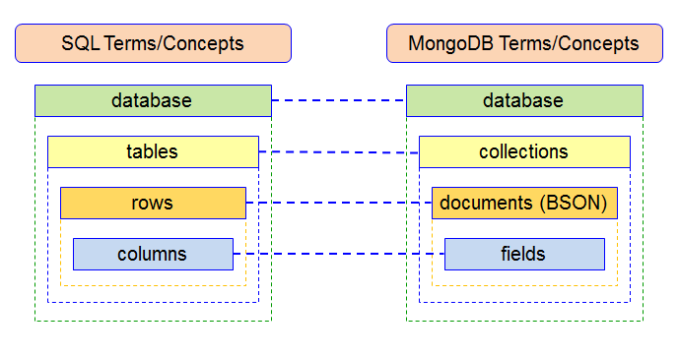
Difference between MongoDB VS SQL ?

Slide 11
Why MongoDB is better than SQL ?
In comparison to the SQL server, MongoDB is faster and more scalable. While the SQL server supports JOIN and Global transactions, MongoDB does not. The MS SQL server does not accommodate large amounts of data, however MongoDB does.
Agile practices are supported by MongoDB, although they are not supported by MS SQL Server.
A SQL database processes SQL queries, whereas MongoDB offers JSON querying. MongoDB is a more dynamic and complicated choice that is appropriate for hierarchical data because of its fundamental properties, as opposed to a SQL Database, which is still more predetermined and appropriate for other types of data storage.
.

Slide 12
Merci de votre attention

